Slide 1
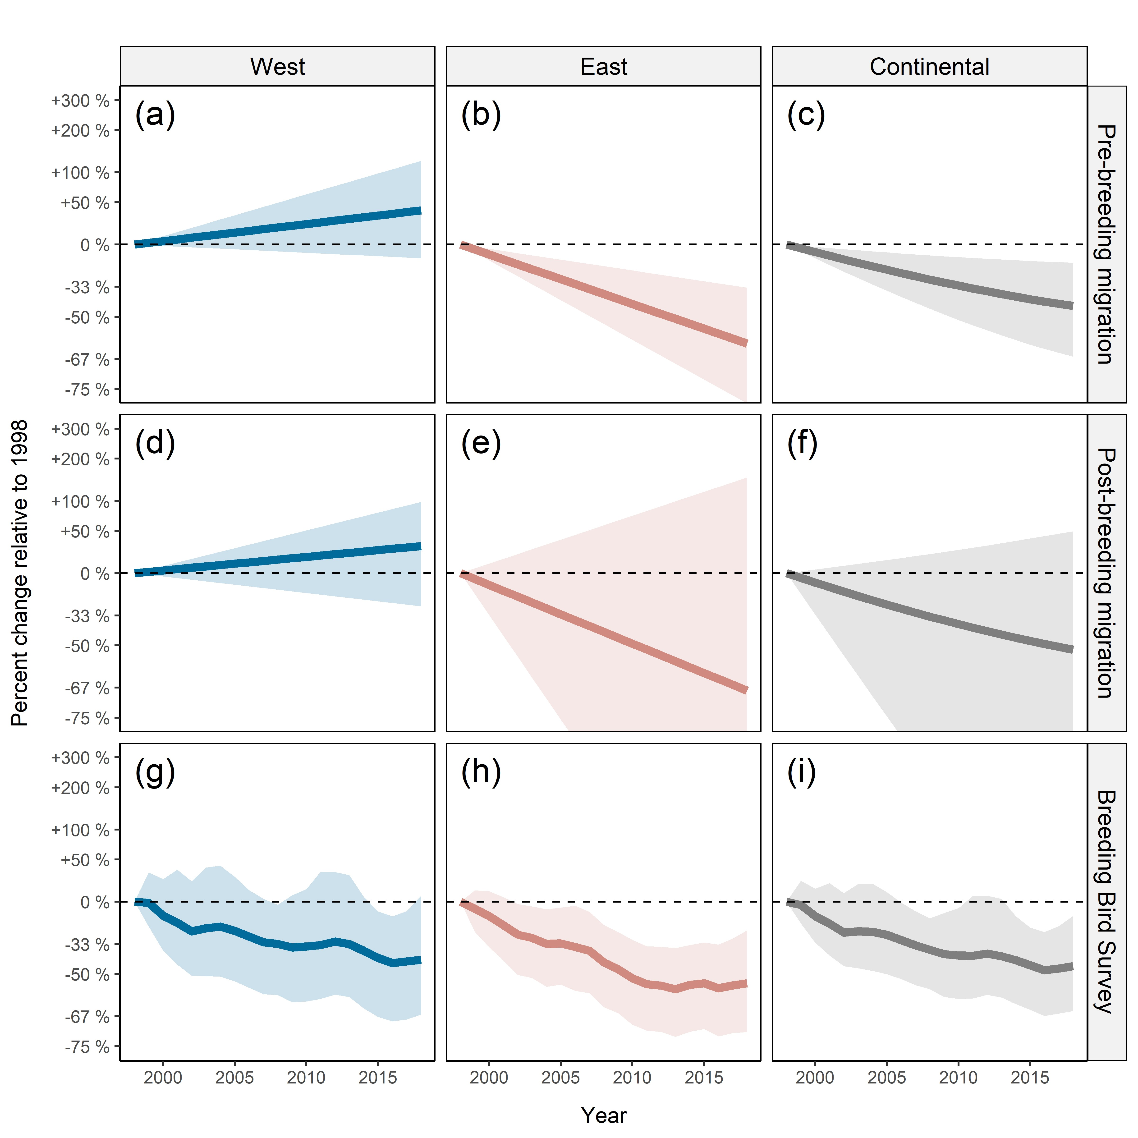
Range-wide population trends from migration monitoring
Estimated Blackpoll Population Trends
David Iles, Ricky Dunn, Danielle Ethier, Kevin Kardynal, Steven Van Wilgenburg
Statistical model to combine catchment and trend information from multiple migration monitoring stations
Divide continent into west and east and strata, estimate trends in each stratum, combine into continental estimates
Results:
Weak evidence of declines in western Canada
(inconsistent with BBS)
Strong evidence of declines in eastern Canada
(consistent with BBS)
Strong evidence of continental declines
(consistent with BBS)

